Slide 1
Kubernetes Introduction
Ondrej Sika
ondrej@ondrejsikalabs.com
@ondrejsika

Slide 2
What is Kubernetes
A Production-Grade Container Orchestration System

Slide 3
What does Kubernetes do?
Abstract away the underlying hardware
Remove concept of nodes
Manage your applications like Cattle instead of like Pets
Deploy your desired state
You (admin) describe the desired state and kubernetes turn it into actual state

Slide 4
Kubernetes Users
From small startups to large enterprises
Google
Yahoo
SAP
Monzo
O2

Slide 5
No vendor lock
Kubernetes is no vendor lock to specific provider, you can run Kubernetes on:
AWS
GCP
DigitalOcean
Azure
OpenStack
or your private infrastructure

Slide 6
For whom is Kubernetes
If you need HA
If you have to manage applications on many servers
If you don't want to care about servers
If you want easily deploy your Dockerized applications
If you need some roles in cluster

Slide 7
Core Concepts
Pod - The basic and atomically schedulable building block of Kubernetes, which is a single instance of app. Pods are mortal.
Deployment - Atomic update of Pods. Deployments contains Pod & ReplicaSet templates and keep running desired pods.
Service - Provide immortal IP address or DNS name for some selected pods.
Namespace - Logical clusters in your cluster.

Slide 8
Kubernetes Cluster Components
API Server - Stateless API server backed by distributed Etcd
Controller Manager - ensure the actual state of the cluster equals the desired state
Scheduler - Binds an unbound Pod to a Node
Kubelet - Client for API Server, run Pods
Kube Proxy - Forward traffic into cluster

Slide 9
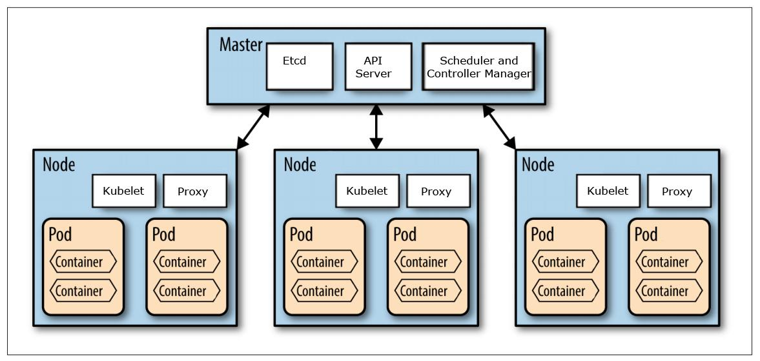

Slide 10
Tools
kubeadm - Tool for Kubernetes cluster setup (on VMs)
kubectl - Kubernetes client
minikube - Run Kubernetes locally
kops - Create Kubernetes cluster in cloud

Slide 11
Kubernetes Components
Workload
Pods
Controllers - Deployments, StatefulSets, Jobs, ...
Service & Load Balancing
Storage
Configuration

Slide 12
sika.link/k8s

Slide 13
Thank you & Questions
Ondrej Sika
email: ondrej@ondrejsikalabs.com www: https://ondrej-sika.cz (all courses) twitter: @ondrejsika linkedin: /in/ondrejsika/
Repo: https://sika.link/k8s Slides: https://sika.link/k8s-slides

